Slide 1

Sri Ram Data Championship 2021 | Round 2
India’s Coal Scenario
Team- OUTLIERS
Assignment for Technology/Business Analyst Internship
Yashas Dewan – yd7336@srmist.edu.in

Slide 2
Understanding the given problem statement
Given Problem Statement : To build a dynamic system that will enable investors to continuously assess the economic and ESG score and provide impact analysis and recommendations
My understanding of the problem statement : To create a system that will be able to access and measure ESG scores and economic data and to provide all possible consequences (impact analysis of a business) and investing recommendations for all industries that the abc group invests in like energy, manufacturing, mining, pharmaceutical etc.

Slide 3
ESG and importance of ESG for investors
What is ESG?
Refers to environmental, social and governance and the way in which these issues converge to impact a company and a company
Importance of ESG for investors: Investors want to ensure that the companies they are investing in are engaging in sustainable and ethical business practices. The ESG implementation delivers financial ROI and benefits such as :
Reducing the companies associated legal and compliance risk
Creating a competitive brand, and sustainable product differentiator that improves the firms value
Helps attracts capital conversation with ESG oriented investors
improves the firms reputation and recognition
In summary ESG is believed to impact overall performance of the company, helps investors, understand and mitigate risk, explore opportunities thereby allows Investors to make sound investment decisions.

Slide 4




Some Existing Companies that provide ESG Scores
Sustainalytics
MSCI ESG Fundamentals
Bloomberg ESG
Morningstar Sustainability Rating

Slide 5
Sustainalytics
Factors unmanageable risk into final score
Rates Organizations from 5 categories (Negligible,Low ,Medium,High,Severe)
Risk goes higher as ESG ratings increase
Measure on which scores are calculated
Environmental
Carbon -Own Operations
Natural resources
Pollution & waste
Environmental opportunities
Social
Business ethics
Human capital
Human Rights Supply chain
board and management quality and integrity
ownership and shareholder rights; remuneration
Governance
Corporate governance
board structure
financial reporting
stakeholder governance

Slide 6
MSCI
Uses Rule Based methodology to identify industry leaders and laggards
Rate Companies from AAA to CCC to their ESG risks
Mange how they manage from peers in the same industry
Measure by which Scores Have Been Calculated
Environmental
Climate change
Natural resources
Pollution & waste
Environmental opportunities
Social
Human capital
Product liability
Stakeholder opposition
Social opportunity
Governance
Corporate governance
Corporate behavior

Slide 7
Bloomberg
Allows integrate ESG data, scores & tools into your investment analysis & workflows.
Measure risk & return against independent ESG benchmarks from Bloomberg & third parties.
Included companies 11000+ organizations calculates analytics on past data
Measure by which Scores Have Been Calculated
Environmental
Air Quality
Climate Change Water & Energy Management
Materials & Waste
Health & Safety
sustainability reports
Energy & emissions
waste data
Social
Diversity
women on board
Independent directors
Workforce Accidents
press releases
Audit Risk & Oversight
Compensation
Board Independence
Governance
Sector specific
Data sources
annual reports
Structure & Tenure
Shareholders’ Rights

Slide 8
MorningStar
Calculates scores based on ESG ratings by sustainalytics
Calculates Sustainability Rating is calculated by scoring every portfolio reported by a fund over the previous twelve month
Gives rating from 0-50
Measure by which Scores Have Been Calculated
Environmental
Sustainability factors
Environment
Climate action
Ecosystem
Social
Basic needs
Human Development Resource
Security
Health of Employees
Governance
Social Governance
pillar scores
Ina Located

Slide 9
Comparison between Competitors
Criteria
ESG RATING Type
Peer Comparison
Graphs within industry
Factors Given
Free Or Subscription Based
Chat Bot
Dashboard
MSCI | From CCC-AAA | Economic Analysis not available | Not Present | Not Provided | Yes | Subscription Based | Not Present
Sustainalytics | From 0-50 in 5 categories | Present | Present | Present | Yes | Partially Free | Present
Bloomberg ESG | Not Provided | Provided | Present | Present | No | Subscription Based | Not Provided
Morning star | From 0-50 | Present | Not Present | Not Present | Not | Subscription Based | Not Present

Slide 10

ESG Factors

Slide 11


Key Performance Indicators that organizations measure while making ESG reports
Environmental Fctors
Greenhouse gas emissions
Energy consumption
Water consumption
Waste generated
Social Factors
Diversity Ratio (Age and Gender)
New hires and turnover of the company
Turnover
Employees availing parental leave
Trainnigs
Healhcare for employees

Slide 12

Govermnet Factors
The Principles for Responsible Banking Index
Task Force on Climate-related Financial Disclosures Index
United Nations Global Compact Index
United Nations Guiding Principles Reporting Framework Index
Know your customer (KYC), Anti-Money-Laundering (AML),
SOURCES OF DATA
Deutsche bank NFA report
https://agm.db.com/files/documents/2022/Non_Financial_Report_2021.pdf
Citi bank ESG report
https://www.citigroup.com/rcs/citigpa/akpublic/storage/public/Global-ESG-Report-2021.pdf
Reliance Industries ESG report
https://www.ril.com/ar2021-22/ESG.html
Brookfield Properties ESG report
https://www.brookfield.com/responsibility/2021-esg-report

Slide 13
Assumptions
All 3 factors environment social and government risk are equal in contributing to the ESG score
When comparing ESG scores some industries have a higher chance of risk than others.
The mining and the energy sector have a higher weightage on environment ESG score.
Tech companies have a higher social score when looked at data security measures,Hence we are assuming that each industry is Independent on each other and the scores are uniform for all industries
We assume that the data provided by the companies to these websites is 100%genuine
Each factor is not dependent on each other as it will make the prediction complex

Slide 14
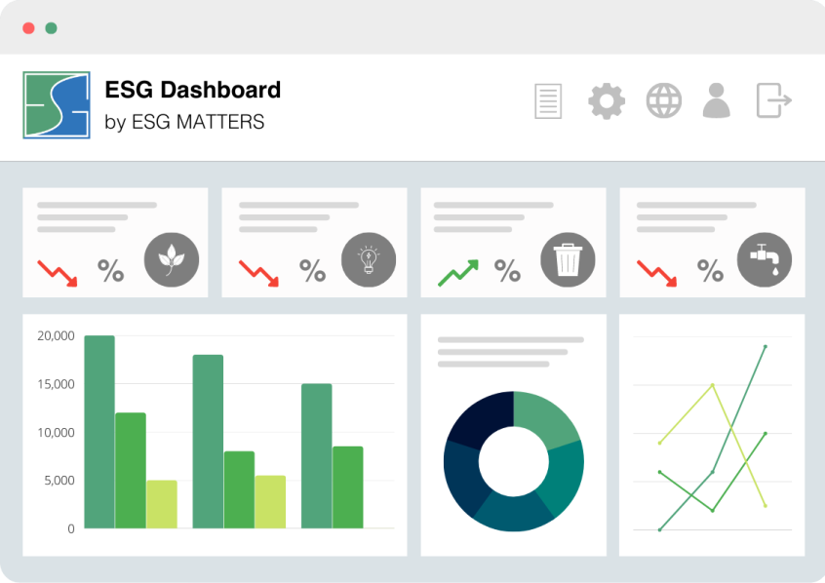
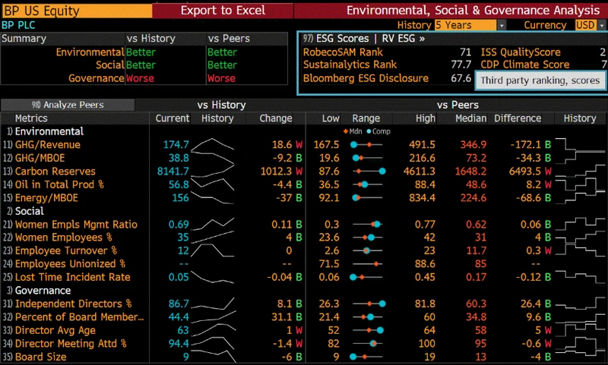
Suggested Dashboards And Results
Dashboards should contain ESG targeted KPI by the corporate and KPI measures and performance against the commitments - A periodic (semi annual/ annual) comparison should be available to check progress). .
Some key aspects to report would be :
For Environment factor:
Greenhouse Gas Emissions levels
Energy consumption - Total and renewable%
Water Consumption - Total and Reused %
Total Waste generated
For Social Factors
Diversity (Gender and Age- eg. Women employee as % of total employee
Turnover of staff Gender and Age:- Women turnover vs. total; young vs. old etc
CSG spends and benefit
Training - Behaviour and technical
Work related injuries / fatalities
recordable work related ill- health
For Governance :
Ethical Conduct
Executive remuneration

Slide 15
References & Appendices
https://www.morningstar.in/
https://www.sustainalytics.com/
https://www.bloomberg.com/
https://finance.yahoo.com/
https://www.pwc.in/
www.rl360.com
www.msci.com
https://cbey.yale.edu/sustainable-finance-esg
https://docs.google.com/presentation/d/15exEEZ4iRE9tU2DSj6OsN3dU2IC8N5Nu/edit?usp=sharing&ouid=103311143494830616780&rtpof=true&sd=true
https://images.app.goo.gl/MohR1Jqiy57jWgbZ7

